Slide 1
Computer Architecture
UNIT-1
Basic Computer Organization and Design
Govind Murari Upadhyay
IINTM, Janakpuri

Slide 2
5-1 Instruction Codes
A process is controlled by a program
  A program is a set of instructions that specify the operations, data, and the control sequence
  An instruction is stored in binary code that specifies a sequence of microoperations
  Instruction codes together with data are stored in memory (Stored Program Concept)

Slide 3
5-1 Instruction Codes ^{cont.}
A computer instruction is a binary code that specifies a sequence of microoperations the computer.
Each computer has its unique instruction set
Instruction codes and data are stored in memory
The computer reads each instruction from memory and places it in a control register
The control unit interprets the binary code of the instruction and proceeds to execute it by issuing a sequence of micro-operations

Slide 4
5-1 Instruction Codes ^{cont.}
An Instruction code is a group of bits that instructs the computer to perform a specific operation (sequence of microoperations). It is divided into parts (basic part is the operation part)
The operation code of an instruction is a group of bits that defines certain operations such as add, subtract, shift, and complement
15 12 11 0
15 12 11 0
Op. Code Address
data
instruction
Not an instruction

Slide 5
5-1 Instruction Codes ^{cont.}
The number of bits required for the operation code depends on the total number of operations available in the computer
2^{n} (or little less) distinct operations → n bit operation code

Slide 6
5-1 Instruction Codes ^{cont.}
It’s an ADD operation
Memory
Op code
Control Unit
110010??????????
Read instruction from memory

Slide 7
5-1 Instruction Codes ^{cont.}
An operation must be performed on some data stored in processor registers or in memory
An instruction code must therefore specify not only the operation, but also the location of the operands (in registers or in the memory), and where the result will be stored (registers/memory)

Slide 8
5-1 Instruction Codes ^{cont.}
Memory words can be specified in instruction codes by their address
Processor registers can be specified by assigning to the instruction another binary code of k bits that specifies one of 2^{k} registers
Each computer has its own particular instruction code format
Instruction code formats are conceived by computer designers who specify the architecture of the computer

Slide 9
5-1 Instruction Codes ^{cont.}
Stored Program Organization
An instruction code is usually divided into operation code, operand address, addressing mode, etc.
The simplest way to organize a computer is to have one processor register (accumulator AC) and an instruction code format with two parts (op code, address)

Slide 10
5-1 Instruction Codes
Stored Program Organization ^{cont.}
0
Memory 4096x16
15
12
11
Opcode
Address
15
0
Instruction Format
Instructions (program)
15
0
Binary Operand
Operands (data)
15
0
Processor register (Accumulator AC)

Slide 11
Direct Addressing
Occurs When the Operand Part Contains the Address of Needed Data.
IR
01 0 1 0 1 0 1 1 0 0 0
1. Address part of IR is placed on the bus and loaded back into the AR
AR
0 1 0 1 1 0 0 1
Memory
2. Address is selected in memory and its Data placed on the bus to be loaded into the Data Register to be used for requested instructions
DR
0 0 0 0 0 0 0 0 1 1 1 0

Slide 12
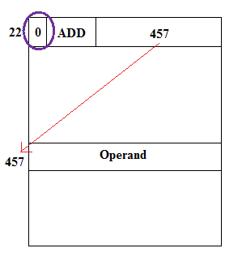
Direct address

Slide 13
Indirect Addressing
Occurs When the Operand Contains the Address of the Address of Needed Data.
IR
1 1 0 1 0 1 0 1 1 0 0 1
1. Address part of IR is placed on the bus and loaded back into the AR
0 1 0 1 1 0 0 1
AR
1 0 1 1 1 0 1 1
2. Address is selected in memory and placed on the bus to be loaded Back into the AR
Memory
3. New Address is selected in memory and placed on the bus to be loaded into the DR to use later
DR
0 0 0 0 0 0 0 0 0 1 0 1

Slide 14
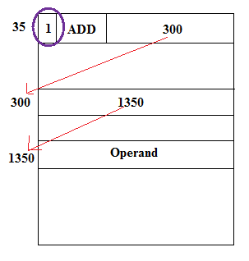
Indirect address

Slide 15
Effective address:
• Effective address: Address where an operand is physically located
Effective address: 457 Effective address: 1350

Slide 16
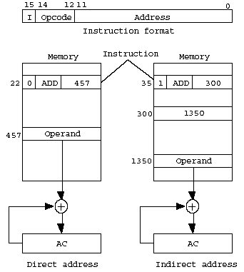
Direct and Indirect addressing example
  Addressing Mode

Slide 17
5-2 Computer Registers
Computer instructions are normally stored in consecutive memory locations and executed sequentially one at a time
The control reads an instruction from a specific address in memory and executes it, and so on
This type of sequencing needs a counter to calculate the address of the next instruction after execution of the current instruction is completed

Slide 18
5-2 Computer Registers ^{cont.}
It is also necessary to provide a register in the control unit for storing the instruction code after it is read from memory
The computer needs processor registers for manipulating data and a register for holding a memory address

Slide 19
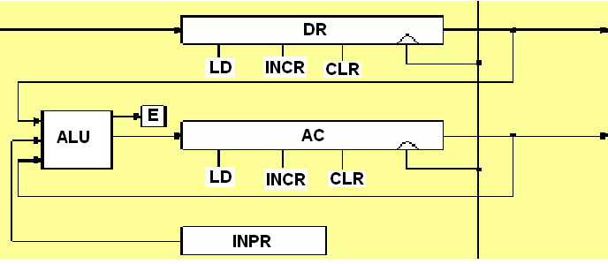
Computer Registers
      Accumulator(AC) : takes input from ALU
        The ALU takes input from DR, AC and INPR :
        ADD DR to AC, AND DR to AC
      Note) Input register is not connected to the bus.
      The input register is connected only to the ALU

Slide 20
5-2 Computer Registers
Data Register(DR) : hold the operand(Data) read from memory
Accumulator Register(AC) : general purpose processing register
Instruction Register(IR) : hold the instruction read from memory
Temporary Register(TR) : hold a temporary data during processing
Address Register(AR) : hold a memory address, 12 bit width

Slide 21
5-2 Computer Registers
Program Counter(PC) :
    hold the address of the next instruction to be read from memory after the current instruction is executed
    Instruction words are read and executed in sequence unless a branch instruction is encountered
    A branch instruction calls for a transfer to a nonconsecutive instruction in the program
    The address part of a branch instruction is transferred to PC to become the address of the next instruction
    To read instruction, memory read cycle is initiated, and PC is incremented by one(next instruction fetch)

Slide 22
5-2 Computer Registers
Input Register(INPR) : receive an 8-bit character from an input device
Output Register(OUTR) : hold an 8-bit character for an output device

Slide 23
Registers in the Basic Computer
11
0
PC
11
0
AR
Memory
15
0
4096 x 16
IR
15
0
15
0
TR
DR
7
0
7
0
15
0
OUTR
INPR
AC
List of BC Registers
  DR 16 Data Register Holds memory operand
  AR 12 Address Register Holds address for memory
  AC 16 Accumulator Processor register
  IR 16 Instruction Register Holds instruction code
  PC 12 Program Counter Holds address of instruction
  TR 16 Temporary Register Holds temporary data
  INPR 8 Input Register Holds input character
  OUTR 8 Output Register Holds output character

Slide 24
S2
S1
Bus
S0
Memory unit
7
4096 x 16
Address
Write
Read
AR
1
LD INR CLR
PC
2
LD INR CLR
DR
3
LD INR CLR
Adder
and
logic
E
Computer Registers Common Bus System
AC
4
LD INR CLR
INPR
IR
5
LD
TR
6
LD INR CLR
OUTR
Clock
LD
16-bit common bus

Slide 25
5-2 Computer Registers
Common Bus System ^{cont.}
S₂S₁S₀: Selects the register/memory that would use the bus
LD (load): When enabled, the particular register receives the data from the bus during the next clock pulse transition
E (extended AC bit): flip-flop holds the carry
DR, AC, IR, and TR: have 16 bits each
AR and PC: have 12 bits each since they hold a memory address

Slide 26
5-2 Computer Registers
Common Bus System ^{cont.}
When the contents of AR or PC are applied to the 16-bit common bus, the four most significant bits are set to zeros
When AR or PC receives information from the bus, only the 12 least significant bits are transferred into the register
INPR and OUTR: communicate with the eight least significant bits in the bus

Slide 27
5-2 Computer Registers
Common Bus System ^{cont.}
INPR: Receives a character from the input device (keyboard,…etc) which is then transferred to AC
OUTR: Receives a character from AC and delivers it to an output device (say a Monitor)
Five registers have three control inputs: LD (load), INR (increment), and CLR (clear)
Register are binary counter with parallel load and synchronous clear

Slide 28
5-2 Computer Registers
Memory Address
The input data and output data of the memory are connected to the common bus, but the memory address is connected to AR
Therefore, AR must always be used to specify a memory address
By using a single register for the address, we eliminate the need for an address bus that would have been needed otherwise

Slide 29
5-2 Computer Registers
Memory Address ^{cont.}
Register → Memory: Write operation
Memory → Register: Read operation (note that AC cannot directly read from memory!!)
Note that the content of any register can be applied onto the bus and an operation can be performed in the adder and logic circuit during the same clock cycle

Slide 30
5-2 Computer Registers
Memory Address ^{cont.}
The transition at the end of the cycle transfers the content of the bus into the destination register, and the output of the adder and logic circuit into the AC
For example, the two microoperations
DR←AC and AC←DR (Exchange)
can be executed at the same time
This is done by:

Slide 31
5-2 Computer Registers
Memory Address ^{cont.}
1- place the contents of AC on the bus (S₂S₁S₀=100)
2- enabling the LD (load) input of DR
3- Transferring the contents of the DR through the adder and logic circuit into AC
4- enabling the LD (load) input of AC
All during the same clock cycle
The two transfers occur upon the arrival of the clock pulse transition at the end of the clock cycle

Slide 32
5-3 Computer Instructions
The basic computer has three instruction formats.
The operation code part of the instruction contain three bits and the remaining 13 bits depends on the operation code encountered.
Basic Computer Instruction code format
Memory-Reference Instructions (OP-code = 000 ~ 110)
15 14
12 11
0
I
Opcode
Address
Register-Reference Instructions (OP-code = 111, I = 0)
15
12 11
0
0 1 1 1
Register operation
Input-Output Instructions (OP-code =111, I = 1)
15
12 11
0
1 1 1 1
I/O operation

Slide 33
BASIC COMPUTER INSTRUCTIONS
Hex Code
Symbol I = 0 I = 1 Description
  AND 0xxx 8xxx AND memory word to AC
  ADD 1xxx 9xxx Add memory word to AC
  LDA 2xxx Axxx Load AC from memory
  STA 3xxx Bxxx Store content of AC into memory
  BUN 4xxx Cxxx Branch unconditionally
  BSA 5xxx Dxxx Branch and save return address
  ISZ 6xxx Exxx Increment and skip if zero
  CLA 7800 Clear AC
  CLE 7400 Clear E
  CMA 7200 Complement AC
  CME 7100 Complement E
  CIR 7080 Circulate right AC and E
  CIL 7040 Circulate left AC and E
  INC 7020 Increment AC
  SPA 7010 Skip next instr. if AC is positive
  SNA 7008 Skip next instr. if AC is negative
  SZA 7004 Skip next instr. if AC is zero
  SZE 7002 Skip next instr. if E is zero
  HLT 7001 Halt computer
  INP F800 Input character to AC
  OUT F400 Output character from AC
  SKI F200 Skip on input flag
  SKO F100 Skip on output flag
  ION F080 Interrupt on
  IOF F040 Interrupt off

Slide 34
5-3 Computer Instructions Instruction Set Completeness
The set of instructions are said to be complete if the computer includes a sufficient number of instructions in each of the following categories:
  Functional Instructions
  - Arithmetic, logic, and shift instructions
  - ADD, CMA, INC, CIR, CIL, AND, CLA
  Transfer Instructions
  - Data transfers between the main memory
  and the processor registers
  - LDA, STA
  Control Instructions
  - Program sequencing and control
  - BUN, BSA, ISZ
  Input/Output Instructions
  - Input and output
  - INP, OUT

Slide 35
5-4 Timing & Control
The timing for all registers in the basic computer is controlled by a master clock generator
The clock pulses are applied to all flip-flops and registers in the system, including the flip-flops and registers in the control unit
The clock pulses do not change the state of a register unless the register is enabled by a control signal (i.e., Load)

Slide 36
5-4 Timing & Control ^{cont.}
The control signals are generated in the control unit and provide control inputs for the multiplexers in the common bus, control inputs in processor registers, and microoperations for the accumulator
There are two major types of control organization:
  Hardwired control
  Microprogrammed control

Slide 37
5-4 Timing & Control ^{cont.}
In the hardwired organization, the control logic is implemented with gates, flip-flops, decoders, and other digital circuits.
In the microprogrammed organization, the control information is stored in a control memory (if the design is modified, the microprogram in control memory has to be updated)
D₃T₄: SC←0

Slide 38
Timing and Control
The SC outputs a string of bits whose value is in the range from 0 to 2 ^{N}-1
  Eg. for L=3, from 0 to 7
We need a way of converting the bit string value to single bit valued outputs labelled T0, T1, T2, T3, and so on, up to Tx (where x = 2^{N}-1)
A decoder serves our purpose, recalling that the output from the DEC is a 1 only on one line (the rest are 0`s)
Tx T2 T1 T0
…..
SC
CLR
INC
L-to-2^{L} DEC
……
…

Slide 39
Timing and Control
Step 1: Where do we fetch the next instruction from at T0 (start time)?
  The Program Counter register (PC) is assumed to hold the address of the next instruction to be executed.
    It is loaded initially during the machine bootstrapping process.
  The PC is transferred to the Address Register (AR) which is connected to the Address Bus Multiplexer.
    The AR provides the selection input to the address bus multiplexer to enable RAM-CPU data transfers
PC
T0 : AR = PC
Load
AR

Slide 40
Timing and Control
Note how the PC is updated in parallel.
This assumes that the next instruction (yet to be executed) in logical sequence is actually located at the next memory location.
This restriction to non-sequential instructions is removed by including instructions that modify the PC explicitly.
Step 2: How do we obtain the instruction from memory at T1?
  The data stored at the selected address is transferred onto the Data Bus and then to the Data Register (DR) in the CPU.
  The instruction data is transferred immediately to the Instruction Register (IR)
Memory
Data bus
INC
M[AR]
DR
LD
PC
IR
LD
CPU bus
AR
LD
Address bus
T1 : DR = M[AR] , IR = DR , PC = PC + 1
NOTE: Mano does not include this step explicitly.
However, in most systems the initial transfer from memory is always to a CPU buffer, such as DR. In effect, this is simply a pipeline element of a transfer circuit that adds an intermediate parallel load through DR to IR.
This can be modified to act as a Master-Slave element which is necessary to build a Direct Memory Access (DMA) control circuit.

Slide 41
Timing and Control
Step 3: How do we decode the instruction intention (ie. meaning, operational definition) at T2?
  The OpCode, Mode and Address field bits all serve as inputs to the Control Logic Gates that select the specific instruction semantics
    Direct addressing
    Indirect addressing
    CPU register addressing
    Input
    Output
NOTE:
All instructions share the steps T0, T1 and T2.
However, depending on what each specific instruction requires, the control logic for higher time steps is more complicated, requiring more inputs.
Note the reference to a DECoder unit to explicitly access the IR bits indicated
T2 : {D0,...,D7} = DEC( IR(12-14) ),
AR = IR(0-11),
I = IR(15)
The AR may be directly connected to the IR address bits indicated

Slide 42
Timing and Control
The instruction cycle consists of a controlled sequence of microoperations using control logic gates and a sequence counter.
I OpCode Address
IR
15 14 13 12 11 0
Connect it all together !
2 1 0
3x8 DEC
7 6 5 4 3 2 1 0
Enable one specific logic circuit
Control
Logic
Gates
Signal the SC to advance (INC) to next timing value, or reset.
Control
Outputs
Timing inputs
F E D C B A 9 ... 1 0
4x16 DEC
3 2 1 0
Clock has not been included!
4-bit
Sequence
Counter (SC)
INC
CLR

Slide 43
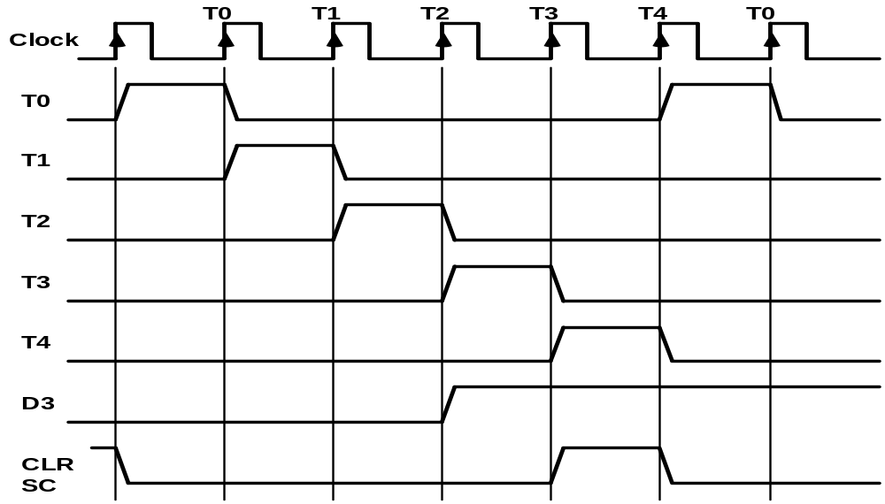
- Generated by 4-bit sequence counter and 4x16 decoder
- The SC can be incremented or cleared.
- Example: T₀, T₁, T₂, T₃, T₄, T₀, T₁, . . .
Assume: At time T₄, SC is cleared to 0 if decoder output D3 is active.
D₃T₄: SC ←0

Slide 44
5-4 Timing & Control ^{cont.}
A memory read or write cycle will be initiated with the rising edge of a timing signal
Assume: memory cycle time < clock cycle time!
So, a memory read or write cycle initiated by a timing signal will be completed by the time the next clock goes through its positive edge
The clock transition will then be used to load the memory word into a register
The memory cycle time is usually longer than the processor clock cycle → wait cycles

Slide 45
5-4 Timing & Control ^{cont.}
T₀: AR←PC
  Transfers the content of PC into AR if timing signal T₀ is active
  T₀ is active during an entire clock cycle interval
  During this time, the content of PC is placed onto the bus (with S₂S₁S₀=010) and the LD (load) input of AR is enabled
  The actual transfer does not occur until the end of the clock cycle when the clock goes through a positive transition
  This same positive clock transition increments the sequence counter SC from 0000 to 0001
  The next clock cycle has T₁ active and T₀ inactive

Slide 46
5-5 Instruction Cycle
A program is a sequence of instructions stored in memory
The program is executed in the computer by going through a cycle for each instruction (in most cases)
Each instruction in turn is subdivided into a sequence of sub-cycles or phases

Slide 47
5-5 Instruction Cycle ^{cont.}
Instruction Cycle Phases:
  1- Fetch an instruction from memory
  2- Decode the instruction
  3- Read the effective address from memory if the instruction has an indirect address
  4- Execute the instruction
This cycle repeats indefinitely unless a HALT instruction is encountered

Slide 48
5-5 Instruction Cycle Fetch and Decode
Initially, the Program Counter (PC) is loaded with the address of the first instruction in the program
The sequence counter SC is cleared to 0, providing a decoded timing signal T₀
After each clock pulse, SC is incremented by one, so that the timing signals go through a sequence T₀, T₁, T₂, and so on.

Slide 49
5-5 Instruction Cycle Fetch and Decode ^{cont.}
  T₀: AR←PC (this is essential!!)
  The address of the instruction is moved to AR.
  T₁: IR←M[AR], PC←PC+1
  The instruction is fetched from the memory to IR , and the PC is incremented.
  T₂: D₀,…, D₇←Decode IR(12-14), AR←IR(0-11), I←IR(15)

Slide 50
Fig: Register Transfers for Fetch Phase
T0: AR ← PC (S2S1S0=010, T0=1)
T1: IR ← M [AR], PC ← PC + 1 (S2S1S0=111, T1=1)
T2: D0, . . . , D7 ← Decode IR(12-14), AR ← IR(0-11), I ← IR(15)
T1
S2
T0
S1
Bus
S0
Memory
7
unit
Address
Read
AR
1
LD
PC
2
INR
IR
5
LD
Clock
Common bus

Slide 51
DETERMINE THE TYPE OF INSTRUCTION
Start
SC ← 0
AR
←
PC
T0
T1
IR
←
M[AR],
PC
←
PC + 1
T2
Decode Opcode in IR(12-14),
AR
←
IR(0-11),
←
I
IR(15)
(Register or I/O) = 1
D7
= 0 (Memory-reference)
(I/O) = 1
= 0 (register)
(indirect) = 1
= 0 (direct)
I
I
T3
T3
T3
T3
Execute
Execute
AR
←
M[AR]
Nothing
input-output
register-reference
instruction
instruction
SC
←
0
SC
←
0
Execute
T4
memory-reference
instruction
SC
←
0
Fig: Flowchart of Instruction Cycle
D'7IT3: AR ← M[AR]
D'7I'T3: Nothing
D7I'T3: Execute a register-reference instr.
D7IT3: Execute an input-output instr.

Slide 52
REGISTER REFERENCE INSTRUCTIONS
Register Reference Instructions are identified when
- D₇ = 1, I = 0
- Register Ref. Instr. is specified in B₀ ~ B₁₁ of IR
- Execution starts with timing signal T₃
r = D₇ I’ T₃ => Register Reference Instruction
B_{i} = IR(i) , i=0,1,2,...,11, the ith bit of IR.
r: SC ← 0
CLA rB₁₁: AC ← 0
CLE rB₁₀: E ← 0
CMA rB₉: AC ← AC’
CME rB₈: E ← E’
CIR rB₇: AC ← shr AC, AC(15) ← E, E ← AC(0)
CIL rB₆: AC ← shl AC, AC(0) ← E, E ← AC(15)
INC rB₅: AC ← AC + 1
SPA rB₄: if (AC(15) = 0) then (PC ← PC+1)
SNA rB₃: if (AC(15) = 1) then (PC ← PC+1)
SZA rB₂: if (AC = 0) then (PC ← PC+1)
SZE rB₁: if (E = 0) then (PC ← PC+1)
HLT rB₀: S ← 0 (S is a start-stop flip-flop)

Slide 53
5.6 MEMORY REFERENCE INSTRUCTIONS
Symbol
Operation
Decoder
Symbolic Description
AND D₀ AC ← AC ∧ M[AR]
ADD D₁ AC ← AC + M[AR], E ← C_{out}
LDA D₂ AC ← M[AR]
STA D₃ M[AR] ← AC
BUN D₄ PC ← AR
BSA D₅ M[AR] ← PC, PC ← AR + 1
ISZ D₆ M[AR] ← M[AR] + 1, if M[AR] + 1 = 0 then PC ← PC+1
- The effective address of the instruction is in AR and was placed there during
timing signal T₂ when I = 0, or during timing signal T3 when I = 1
- Memory cycle is assumed to be short enough to be completed in a CPU cycle
- The execution of MR Instruction starts with T₄
AND to AC
D₀T₄: DR ← M[AR] Read operand
D₀T₅: AC ← AC ∧ DR, SC ← 0 AND with AC
ADD to AC
D₁T₄: DR ← M[AR] Read operand
D₁T₅: AC ← AC + DR, E ← C_{out}, SC ← 0 Add to AC and store carry in E

Slide 54
MEMORY REFERENCE INSTRUCTIONS^{cont.}
LDA: Load to AC
D₂T₄: DR ← M[AR]
D₂T₅: AC ← DR, SC ← 0
STA: Store AC
D₃T₄: M[AR] ← AC, SC ← 0
BUN: Branch Unconditionally
D₄T₄: PC ← AR, SC ← 0
BSA: Branch and Save Return Address
M[AR] ← PC, PC ← AR + 1
Memory, PC, AR at time T4
Memory, PC after execution
20
0
BSA
135
20
0
BSA
135
Return address: PC = 21
Next instruction
21
Next instruction
AR = 135
135
21
136
Subroutine
PC = 136
Subroutine
1
BUN
135
1
BUN
135
Memory
Memory

Slide 55
Memory Reference Instructions^{cont.}
BSA: executed in a sequence of two micro-operations:
D₅T₄: M[AR] ← PC, AR ← AR + 1
D₅T₅: PC ← AR, SC ← 0
ISZ: Increment and Skip-if-Zero
D₆T₄: DR ← M[AR]
D₆T₅: DR ← DR + 1
D₆T6: M[AR] ← DR, if (DR = 0) then (PC ← PC + 1), SC ← 0

Slide 56
Memory-reference instruction
AND
ADD
LDA
STA
D T
D T
D T
D T
0
4
1
4
2
4
3
4
DR ←M[AR]
DR ←M[AR]
DR ← M[AR]
M[AR] ← AC
SC ← 0
D T
D T
D T
0
5
1
5
2
5
∧
AC ← AC DR
AC ← AC + DR
AC ← DR
SC <- 0
E ← Cout
SC ← 0
SC ← 0
BUN
BSA
ISZ
D T
D T
D T
4
4
5
4
6
4
PC ← AR
M[AR] ← PC
DR ← M[AR]
SC ← 0
AR ← AR + 1
D T
D T
5
5
6
5
PC ← AR
DR ← DR + 1
SC ← 0
D T
6
6
M[AR] ← DR
If (DR = 0)
then (PC ← PC + 1)
SC ← 0

Slide 57
5-7 Input-Output and Interrupt
Instructions and data stored in memory must come from some input device
Computational results must be transmitted to the user through some output device
For the system to communicate with an input device, serial information is shifted into the input register INPR
To output information, it is stored in the output register OUTR

Slide 58
5-7 Input-Output and Interrupt^{cont.}
Input-output
Serial
registers and
terminal
communication
Computer
interface
flip-flops
Printer
Receiver
OUTR
FGO
interface
AC
Keyboard
Transmitter
INPR
FGI
interface
Serial Communications Path
Parallel Communications Path

Slide 59
5-7 Input-Output and Interrupt^{cont.}
INPR and OUTR communicate with a communication interface serially and with the AC in parallel. They hold an 8-bit alphanumeric information
I/O devices are slower than a computer system → we need to synchronize the timing rate difference between the input/output device and the computer.
FGI: 1-bit input flag (Flip-Flop) aimed to control the input operation

Slide 60
5-7 Input-Output and Interrupt ^{cont.}
FGI is set to 1 when a new information is available in the input device and is cleared to 0 when the information is accepted by the computer
FGO: 1-bit output flag used as a control flip-flop to control the output operation
If FGO is set to 1, then this means that the computer can send out the information from AC. If it is 0, then the output device is busy and the computer has to wait!

Slide 61
5-7 Input-Output and Interrupt^{cont.}
The process of input information transfer:
  Initially, FGI is cleared to 0
  An 8-bit alphanumeric code is shifted into INPR (Keyboard key strike) and the input flag FGI is set to 1
  As long as the flag is set, the information in INPR cannot be changed by another data entry
  The computer checks the flag bit; if it is 1, the information from INPR is transferred in parallel into AC and FGI is cleared to 0
  Once the flag is cleared, new information can be shifted into INPR by the input device (striking another key)

Slide 62
5-7 Input-Output and Interrupt^{cont.}
The process of outputting information:
  Initially, the output flag FGO is set to 1
  The computer checks the flag bit; if it is 1, the information from AC is transferred in parallel to OUTR and FGO is cleared to 0
  The output accepts the coded information (prints the corresponding character)
  When the operation is completed, the output device sets FGO back to 1
  The computer does not load a new data information into OUTR when FGO is 0 because this condition indicates that the output device is busy to receive another information at the moment!!

Slide 63
Input-Output Instructions
Needed for:
  Transferring information to and from AC register
  Checking the flag bits
  Controlling the interrupt facility
The control unit recognize it when D₇=1 and I = 1
The remaining bits of the instruction specify the particular operation
Executed with the clock transition associated with timing signal T₃
Input-Output instructions are summarized next

Slide 64
Input-Output Instructions
D₇IT₃ = p
IR(i) = B_{i}, i = 6, …, 11
INP pB₁₁: AC(0-7) ← INPR, FGI ← 0 Input char. to AC
OUT pB₁₀: OUTR ← AC(0-7), FGO ← 0 Output char. from AC
SKI pB₉: if(FGI = 1) then (PC ← PC + 1) Skip on input flag
SKO pB₈: if(FGO = 1) then (PC ← PC + 1) Skip on output flag
ION pB₇: IEN ← 1 Interrupt enable on
IOF pB₆: IEN ← 0 Interrupt enable off

Slide 65
Program Interrupt
The process of communication just described is referred to as Programmed Control Transfer
The computer keeps checking the flag bit, and when it finds it set, it initiates an information transform (this is sometimes called Polling)
This type of transfer is in-efficient due to the difference of information flow rate between the computer and the I/O device
The computer is wasting time while checking the flag instead of doing some other useful processing task
An alternative to the programmed controlled procedure is to let the external device inform the computer when it is ready for the transfer
This type of transfer uses the interrupt facility

Slide 66
Program Interrupt^{cont.}
While the computer is running a program, it does not check the flags
Instead:
  When a flag is set, the computer is immediately interrupted from proceeding with the current program
  The computer stops what it is doing to take care of the input or output transfer
  Then, it returns to the current program to continue what it was doing before the interrupt
The interrupt facility can be enabled or disabled via a flip-flop called IEN
The interrupt enable flip-flop IEN can be set and cleared with two instructions (IOF, ION):
  IOF: IEN ← 0 (the computer cannot be interrupted)
  ION: IEN ← 1 (the computer can be interrupted)

Slide 67
Program Interrupt^{cont.}
Another flip-flop (called the interrupt flip-flop R) is used in the computer’s interrupt facility to decide when to go through the interrupt cycle
FGI and FGO are different here compared to the way they acted in an earlier discussion!!
So, the computer is either in an Instruction Cycle or in an Interrupt Cycle
The interrupt cycle is a hardware implementation of a branch and save return address operation (BSA)
The return address available in PC is stored in a specific location where it can be found later when the program returns to the instruction at which it was interrupted
This location may be a processor register, a memory stack, or a specific memory location

Slide 68
Program Interrupt^{cont.}
For our computer, we choose the memory location at address 0 as a place for storing the return address
Control then inserts address 1 into PC: this means that the first instruction of the interrupt service routine should be stored in memory at address 1, or, the programmer must store a branch instruction that sends the control to an interrupt service routine!!

Slide 69
Program Interrupt^{cont.}
R = Interrupt flip-flop
Instruction cycle
=0
R
=1
Interrupt cycle
Fetch and decode
Store return address
instructions
in location 0
M[0] ← PC
Execute
IEN
=0
instructions
=1
Branch to location 1
=1
PC ← 1
FGI
=0
=1
IEN ← 0
R ← 0
FGO
=0
R ← 1
Flowchart for interrupt cycle

Slide 70
Interrupt Cycle
The fetch and decode phases of the instruction cycle must be :
(Replace T0, T1, T2 → R'T0, R'T1, R'T2 (fetch and decode phases occur at the instruction cycle when R = 0)
Interrupt Cycle:
  RT₀: AR ← 0, TR ← PC
  RT₁: M[AR] ← TR, PC ← 0
  RT₂: PC ← PC + 1, IEN ← 0, R ← 0, SC ← 0

Slide 71
5-10 Design of Accumulator Logic
Circuits associated with AC
16
16
Adder and
16
16
From DR
logic
AC
8
circuit
To bus
From INPR
LD
INR
CLR
Clock
Control
gates
All the statements that change the content of AC
D₀T₅: AC ← AC ∧ DR AND with DR
D₁T₅: AC ← AC + DR Add with DR
D₂T₅: AC ← DR Transfer from DR
pB₁₁: AC(0-7) ← INPR Transfer from INPR
rB₉: AC ← AC’ Complement
rB₇ : AC ← shr AC, AC(15) ← E Shift right
rB₆ : AC ← shl AC, AC(0) ← E Shift left
rB₁₁ : AC ← 0 Clear
rB₅ : AC ← AC + 1 Increment
cpe 252: Computer Organization

Slide 72
5-10 Design of Accumulator Logic^{cont.}
Gate structures for controlling
the LD, INR, and CLR of AC
From Adder
16
16
To bus
and Logic
AC
D
AND
Clock
0
LD
T
5
INR
D
ADD
1
CLR
D
LDA
2
T
5
p
INPR
B
11
r
COM
B
9
SHR
B
7
SHL
B
6
INC
B
5
CLR
B
11

